Slide 1
ICOMPARE
By
Amit Rajoriya
Anushri Srinath Aithal
Ashwini Shankar Narayan
Mojdeh Keykhanzadeh
Notes:
Introduction - Anushri

Slide 2
Project Overview
ICompare User Portal
Price Comparison Web Application
Search for Products
Wish List Option
Integration with Semantics API
https://ec2-54-89-178-39.compute-1.amazonaws.com
Notes:
Amit

Slide 3
Project Overview
Admin Portal
Okta Based SSO Access to Admin App
Redirect to API Settings Page
Access Jenkins integration with Okta SSO
https://54.177.122.80:8090/
Notes:
Amit

Slide 4
DEMO
Notes:
Node - Amit , Ashwini - SSO

Slide 5
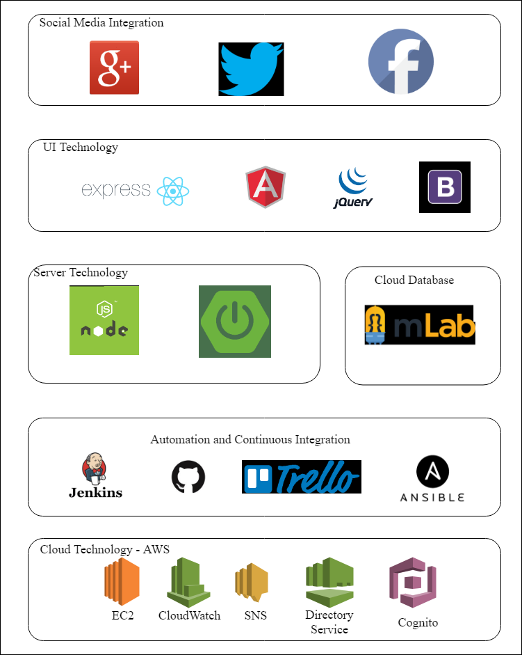
Architecture
Notes:
Mojedh

Slide 6
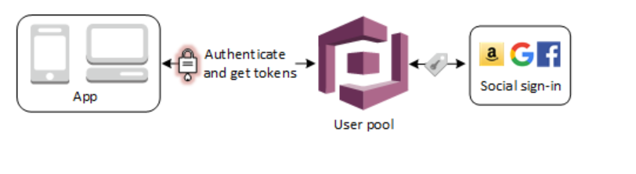
Cognito
Source:https://docs.aws.amazon.com/cognito/latest/developerguide/cognito-user-pools-social.html
Notes:
Mojedh

Slide 7
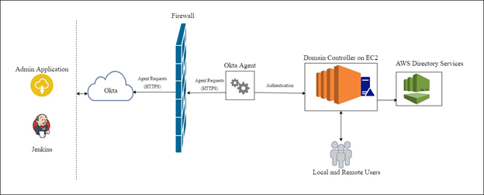
Okta Active Directory Integration
Notes:
Anushri

Slide 8
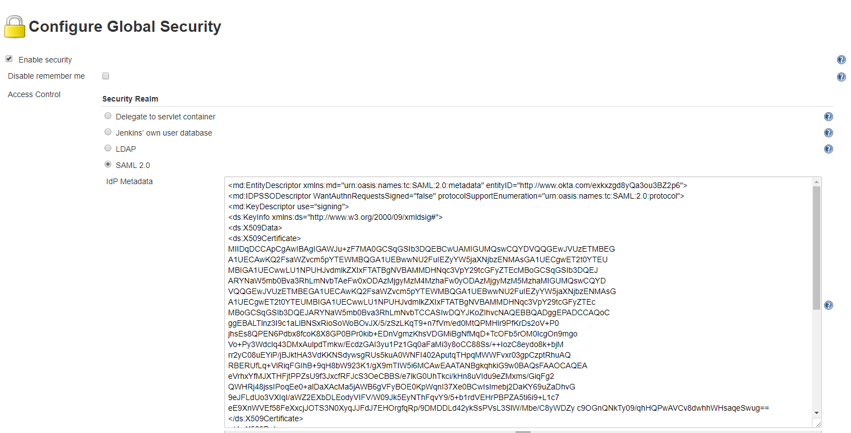
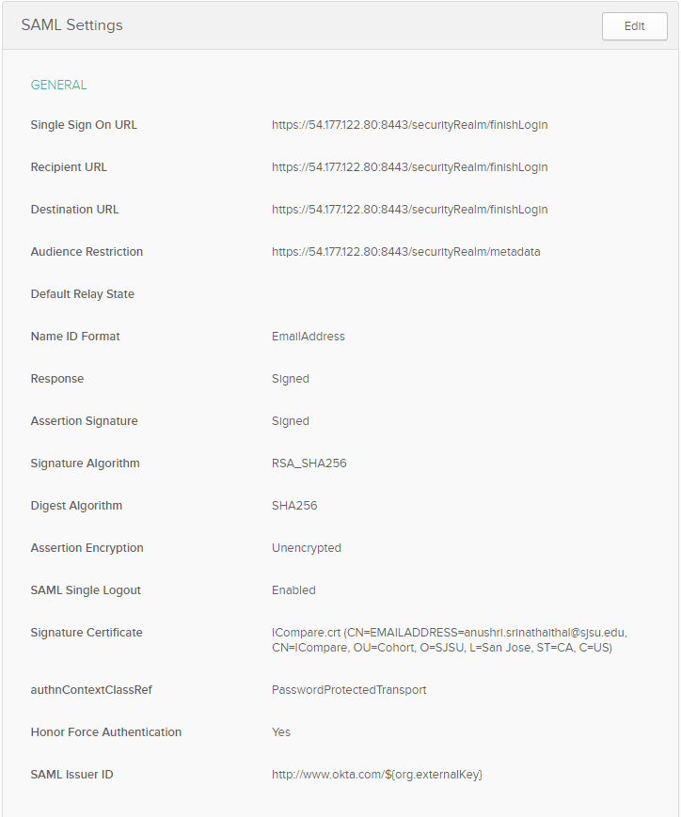
Okta Jenkins Integration
Install Jenkins on EC2
Configure Jenkins to run on HTTPs
Install SAML Plugin
Create Jenkins SAML SSO app in Okta
Configure IDP Metadata with the Okta certificate
Configure logout URL
Notes:
Anushri

Slide 9
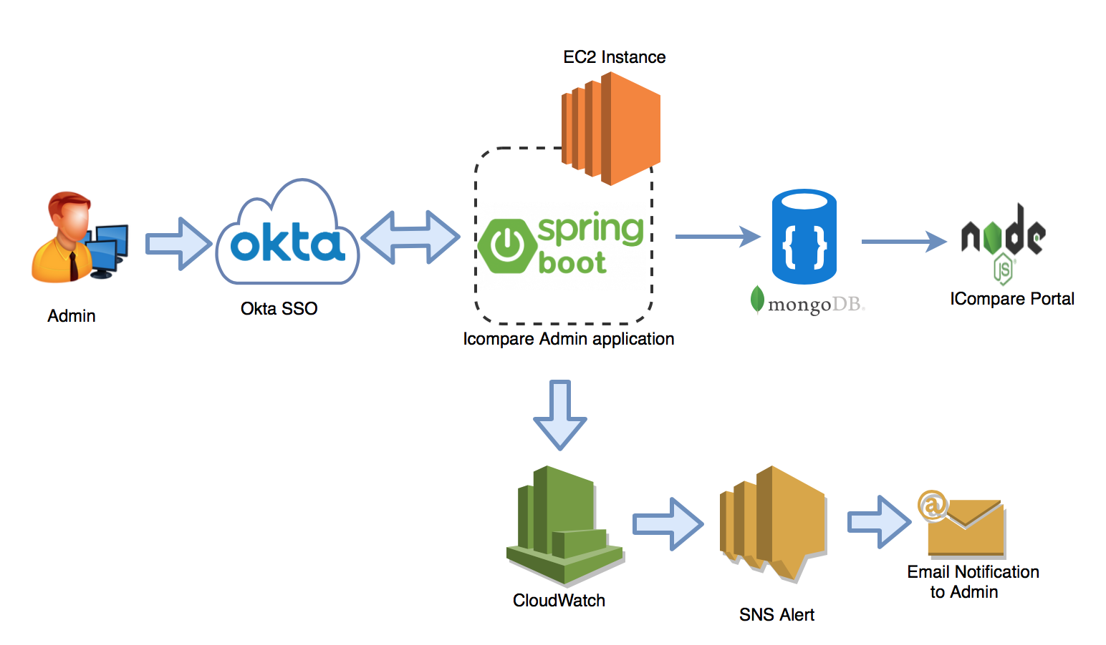
Admin Portal Integration
Notes:
Ashwini

Slide 10
Best Practices & Process
Continuous Integration & deployment
Automation Testing using Mocha & Chai
MVC Architecture
Agile Methodology
Notes:
Amit

Slide 11
Challenges
Cognito Integration
Facebook Redirect Error
Integration with Okta
30 day free trial
Windows Server EC2 free tier memory limits
Notes:
Mojedh + Anushri

Slide 12
Thanks!
Any questions?

